Slide 1
Universal Stand

Slide 2
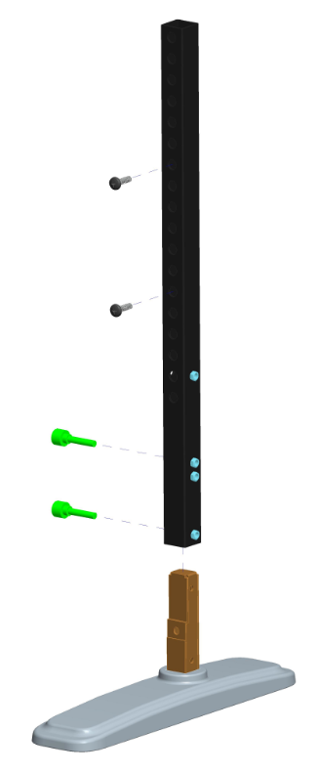
What is Universal Stand?
Screw
for VESA Mount
Tube
Handy Screw
for mounting stand and tube
TPV Standard Stand

Slide 3
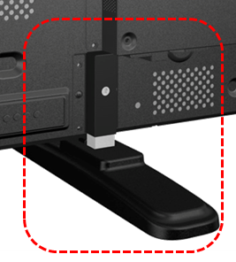
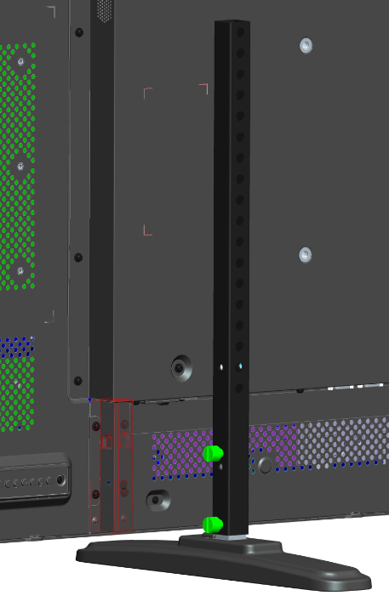
What Universal Stand can do?
Stable
Current Design:
Use standard stand only.
Display should design special stand cover to hold the stand.
Fit to all display which have wall mount holes meet VESA requirement.
Stand cover could be remove from display.

Slide 4
Combination of Universal Stand for 32”~65”
BDL3250EL
BDL3220QL
BDL3250EL
BDL3220QL
Tube (S)
Standard Stand (S)
BDL4250EL
BDL4271VL
BDL4650EL
BDL4671VL
BDL4220QL
BDL4620QL
BDL5520QL
Tube (M)
Standard Stand (M)
Tube (L)
Standard Stand (L)
BDL4250EL
BDL4271VL
BDL4650EL
BDL4671VL
BDL5551EL
BDL5551EL
BDL6520EL
BDL6520ET
BDL6524ET
BDL4220QL
BDL4620QL
BDL5520QL
Stand (XL) (*)
BDL6520EL
BDL6520ET
BDL6524ET

Slide 5
Items require special attention
Tip over test must be pass for safety concern.
Incorrect combination of stand and tube could be dangerous.
Incorrect fix position could be dangerous.
➔ Prepare detail install instruction.
No XL size stand could be use. (Current stand belongs to N company)
Need to design new stand cover and open a new tooling for it.

Slide 6
Cost Information *Reference only
Stand | Standard Stand (S) | Standard Stand (M) | Standard Stand (L) | Stand (XL)
Cost | $25.4 | $30.8 | $32.10 | $36.0
Tooling Cost | N/A | N/A | N/A | $8,000
Tube + Screw | S | M | L
Cost | $6.75 | $10.5 | $16.5

